Slide 1


2014 Year in Review
HeW Student Support Staff
This workforce solution is 100% funded by an $11.7m grant awarded by the U.S. Department of Labor's Employment and Training Administration. The solution was created by the grantee and does not necessarily reflect the official position of the U.S. Department of Labor. The Department of Labor makes no guarantees, warranties, or assurances of any kind, express or implied, with respect to such information, including any information on linked sites and including, but not limited to, accuracy of the information or its completeness, timeliness, usefulness, adequacy, continued availability or ownership.

Slide 2
HeW Student Support Staff
  Joined HeW project in 2014:
  Pat Lange, Clover Park (SN) - May
  Pierre Matte, Bellevue (SN) – Aug.
  Erika Coddington, NOVA (SN) – Sept.
  John Bird, NOVA (Vet SN) – Sept.
  Michelle Heitman, Whatcom (SN) – Oct.
  Trisha Haakonstad, Clark (SN) – Dec.
Joined HeW project before 2014:
  Jennifer Hemker, Bellevue (IS)
  Matt Bryant, Bellingham (SN)
  Brandy Feber-Christensen, Pierce (SN)
  Chantal Carrancho, Renton (SN)
  Ashley Hart, Renton (IS)
  Fran Kwak, Renton (IS)
  Mary Hubler, Spokane (SN)
IS – Instructional Support
SN – Student Navigator

Slide 3
2014 Monthly Meetings
January
“Recruiting & Employment Goals”
HeW Navigator Quarterly Goals
February
“Recruiting TAA Participants”
Guest Speakers: Caitlyn & Bill, WA Labor Council
March
“Attracting & Retaining Employers”
Guest Speaker: Yvette, Recruiter, PATH
April
“JBLM Vet Recruiting & LinkedIn Employment Group”
HeW Consortium Updates
May
“Embrace the Near Win” Coaching Conversation
Ted Talk by Sarah Lewis & Discussion
June
“Best Practices for Resumes with a Health IT Focus”
Facilitated by Adriana at Clark College

Slide 4
2014 Monthly Meetings
July
“Connecting with Veterans”
Veteran Panel facilitated by Brandy from Pierce College
August
“Student Coaching: Time Management”
Guest Speaker: Ron Taplin from Bellevue College, facilitated by Jennifer Hemker
Sept.
“Optimizing LinkedIn Profiles & Other Tips from a Health IT Recruiter”
Guest Speaker: Matt, Health IT Recruiter from Greythorn
October
“Appreciative Inquiry & Best Practices for Recruiting, Retention & Employment”
HeW In-Person Consortium Breakout
Nov.
“Job Interview Preparation Tips”
Guest Speakers: Hannah & Jessica, Recruiters from ComForce
Dec.
“2014 Year in Review & Planning/Goal Setting for 2015”
HeW Feedback, Focus on Employment & SMART Goals

Slide 5

Best Practices: Recruiting
Use LinkedIn. Join groups that will provide access to target individuals.
Hold “Lunch with an Advisor” for an hour to provide general advising in cafeteria and present HIT program information to students.
Attend industry Meetup groups.
Sponsor industry events.
Do a Strengths, Weaknesses, Opportunities, and Threats (SWOT) Analysis of programs to determine the most significant program strengths and capitalize on opportunities.
Make classroom visits to promote offerings with programs that overlap.
Attend resource fairs and WorkSource events to advertise.
Make cold calls.
Maintain an active connection with on-campus veterans’ clubs.
Use student panels. Students are mostly interested in hearing from other students.

Slide 6

Best Practices: Retention/Coaching
Create a personal success plan for new students. One-page survey identifying challenges. Email plan with recommendations to the student.
Use the ISP for direction to ask questions of all students to identify those that need help.
Celebrate and recognize students’ small successes (grades, etc.). Students respond positively to the acknowledgement.
Provide veteran-specific space and resource for veteran students.
Buddy programs; pair ESL students with native English speakers to practice using medical terms.
Volunteering opportunities for ESL students that give them basic experience while allowing them to work with patients that speak their language.
Film workshops and share the links with students who cannot attend.
Time management: Put your plan on the refrigerator. Meet with your peer group.

Slide 7

Best Practices: Employment
  Video record mock interviews.
  Attend job fairs and networking events to connect with employers.
  Connect specific students with specific employers based on skills and interests.
  Ask students questions to determine potential road blocks they might face in the employment process and working to remove those.
  Connect students with their peers to find out what works.
  Offer to edit students’ resumes over email with an in-person follow-up if needed.
  Offer job preparedness and professional development courses.
  Create veteran-specific career resources.
  Optimize LinkedIn profiles.
  Connect with employers and recruiters on LinkedIn.

Slide 8
Feedback
    What is one thing you would have liked to see more of and why?
    What is one thing you would have liked to see less of and why?

Slide 9

2015 Planning
HeW Student Support Staff

Slide 10

HeW Focus on Employment
HeW Employment Checklist
Internships & Employment Assistance Chart
HeW Resume Template
Bi-Monthly E-Newsletter with Job Postings
LinkedIn Employment Group with Job Postings
Quarterly Navigator Employment Goals
Employer & Recruiter Connections
Employment Trends and Resources
Individual Coaching

Slide 11
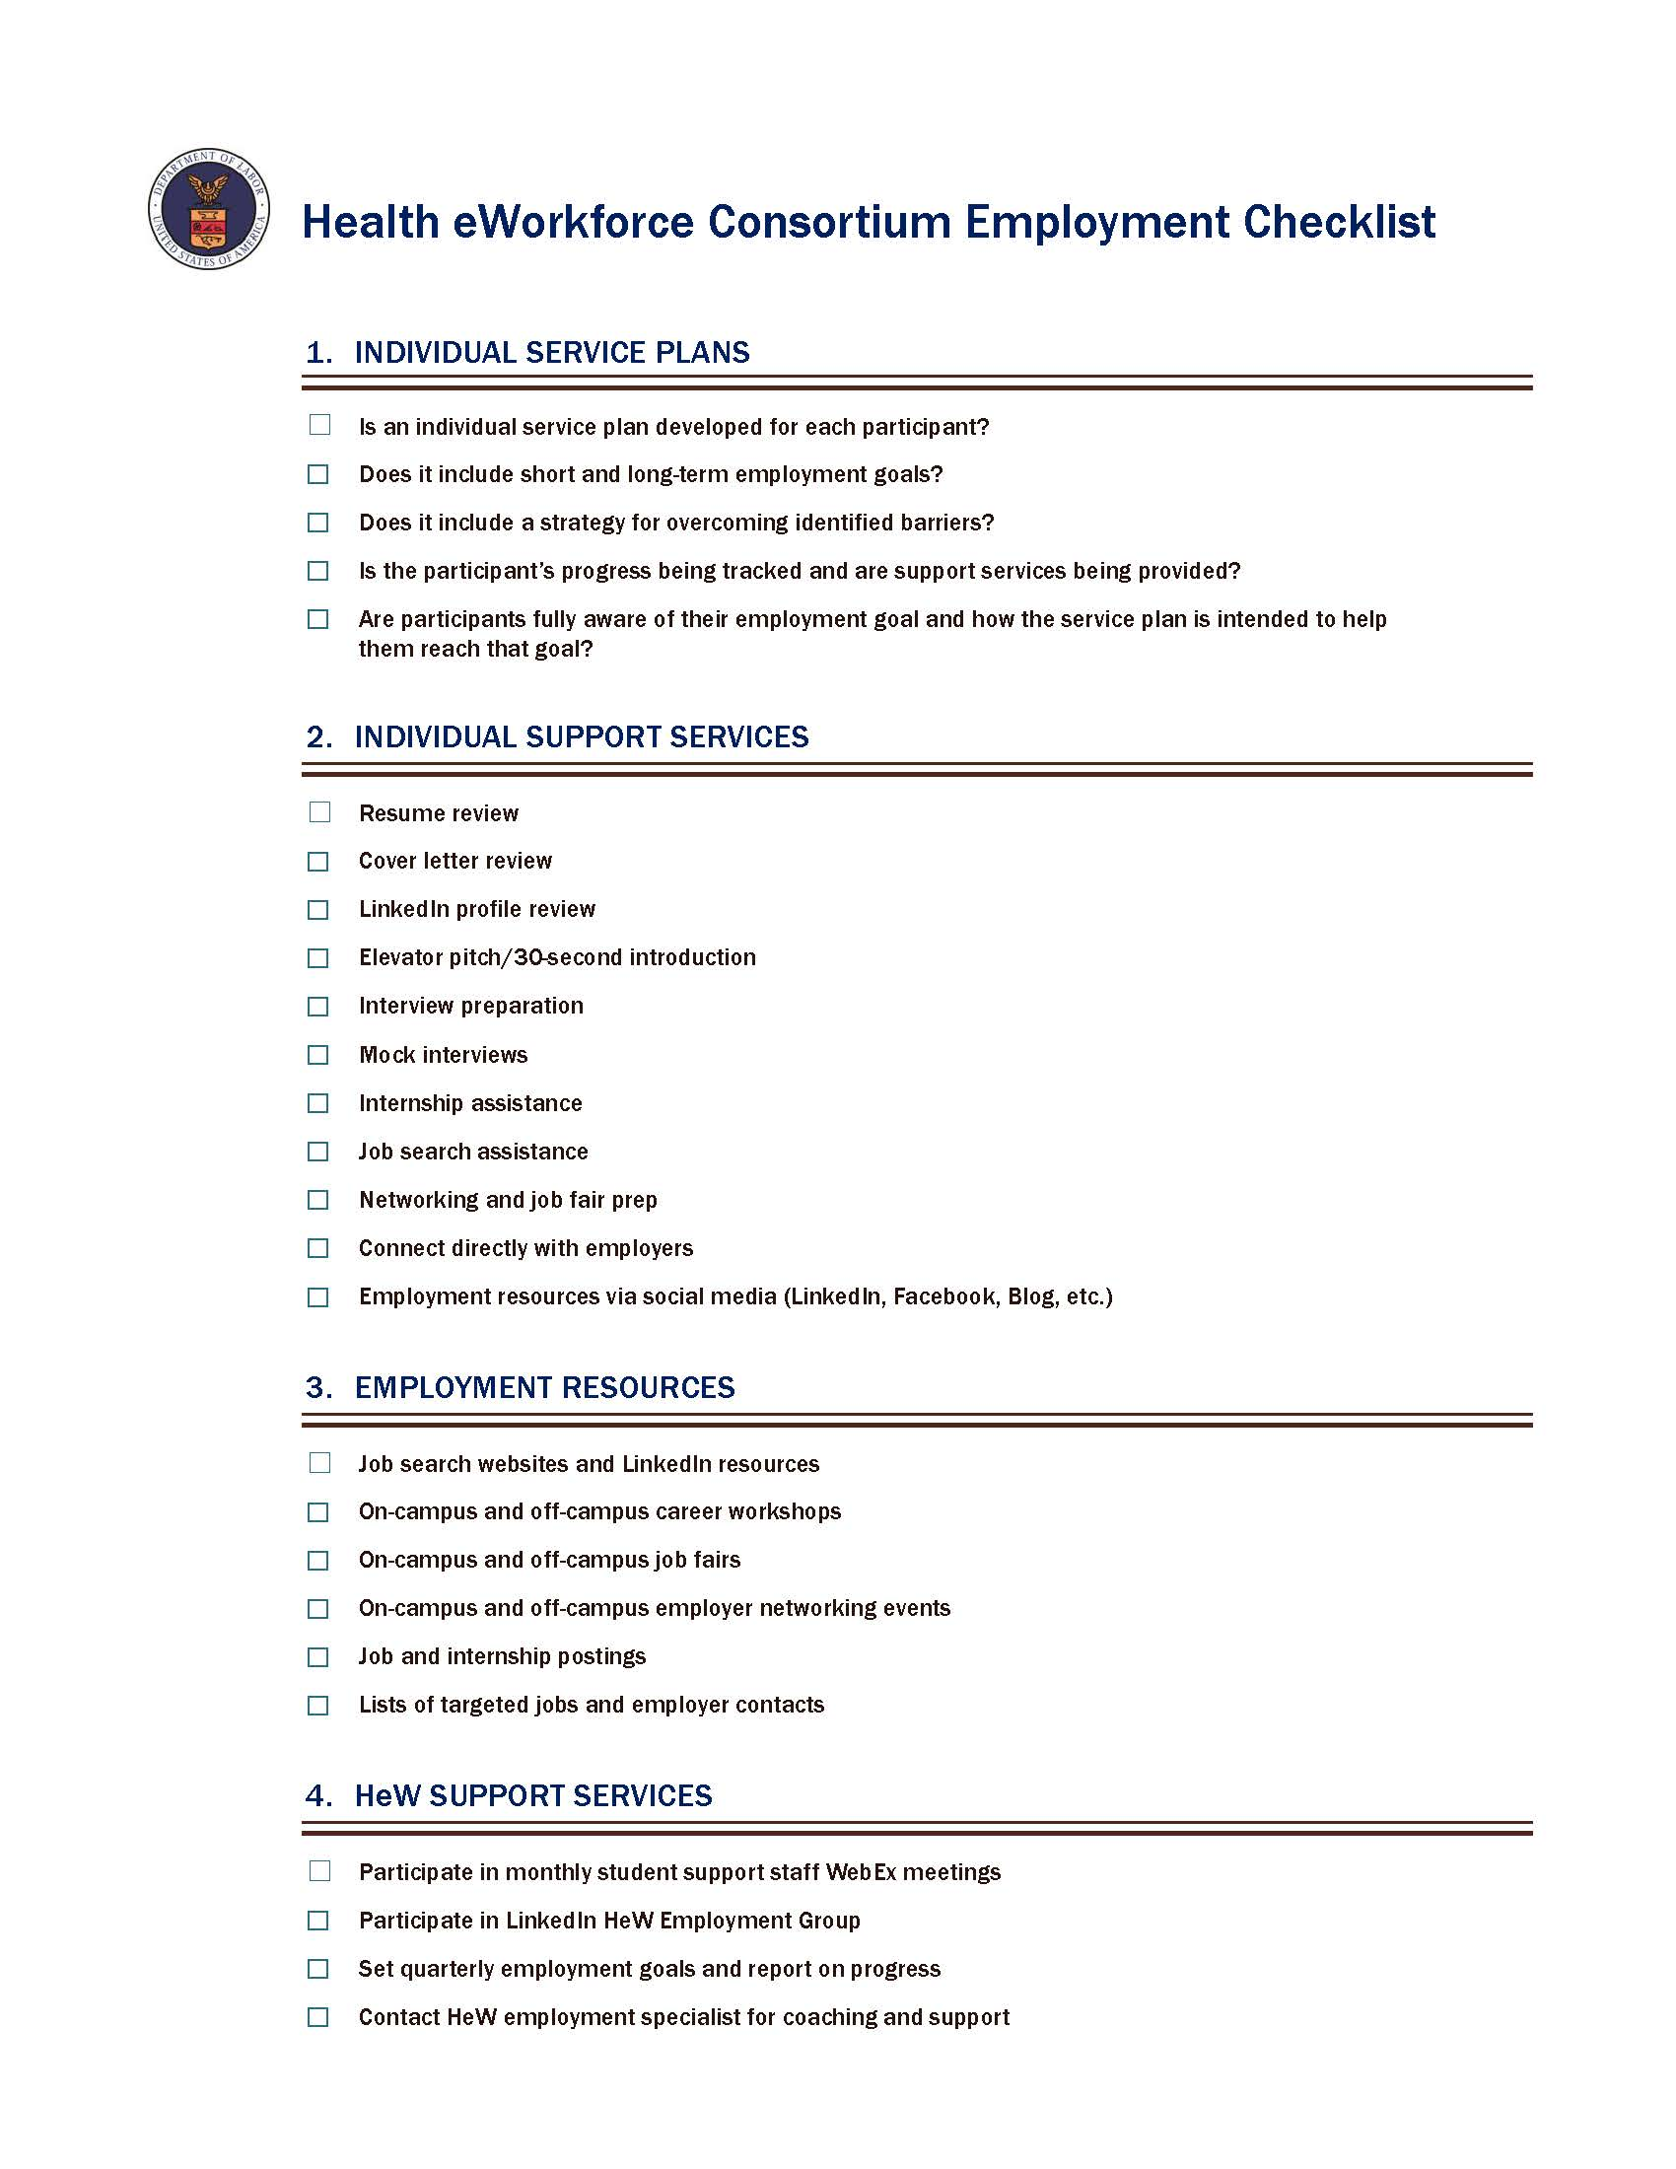

Slide 13
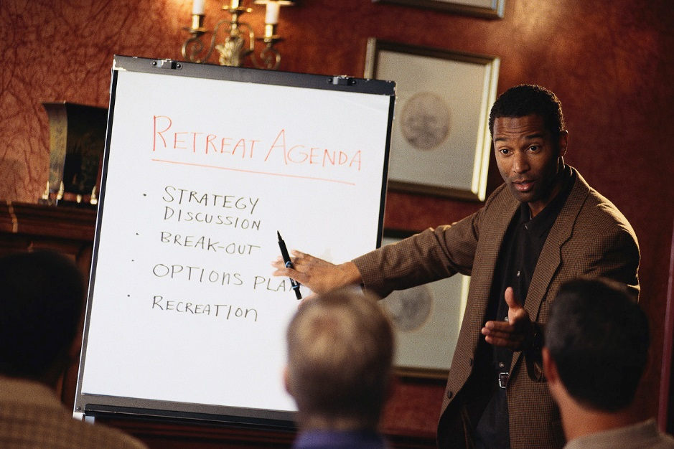
Meeting Format
Agenda:
  Guest Speakers/Panel
  Topics: Recruiting, Retention/Coaching & Employment
  Challenges & Best Practices
  Round of Commitments
Rotating Facilitators
One Hour
Fourth Wednesdays, 1-2 pm Pacific

Slide 14

Group Discussion
Planning for 2015 Monthly Student Support Staff Meetings:
  Topics
  Facilitators
  Format
  Other

Slide 15


Quarterly Goals
Share one success from last quarter.
Share one challenge from last quarter.

Slide 16
Commitments
    What is one thing you would like to do more of and why?
    What is one thing you would like to do less of and why?

Slide 17

SMART Goals Review
Specific: What exactly are you going to do, when, and how?
Measurable: What criteria will you use to determine your progress?
Attainable: Is it realistic and within your control?
Relevant: Is it challenging and meaningful?
Time-bound: Have you given yourself a deadline?

